Slide 1
INTRODUCTION TO VECTORISATION AND SEMANTIC SEARCH Transforming Data into Meaningful Insights
Presented by John Staveley MVP

Slide 2

Welcome
Hello, I’m John Staveley
25 years as software engineer
Community lead at Leeds Data Science, Leeds Sharp and the AIoTHub

Slide 3

Why VECTORiSATION matters
Search engine icon → “Better search results”
Shopping cart → “Smarter recommendations”
AI brain → “Semantic understanding”

Slide 4
LEXICAL VS Similarity search
Text = “The Quick brown fox jumped over the lazy dog”
Lexical Search: Text Contains ‘Dog’
Semantic Search: Text Contains ‘Animal’

Slide 5
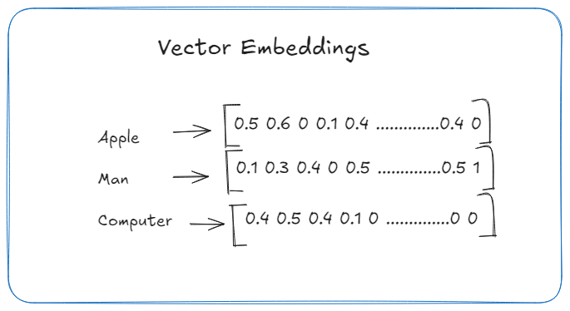
VECTORISATION BASICS
What is a vector?
“Text” → embedding vector (small table of numbers)
“Image/Sound/Video” → feature vector

Slide 6
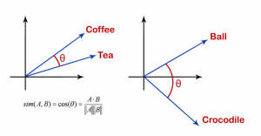
SIMILARITY METRICS

Slide 7
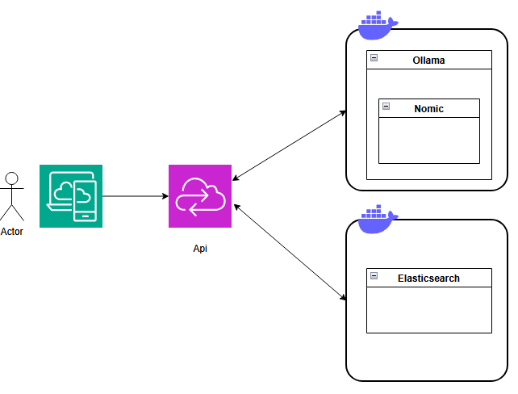
ARCHitecture

Slide 8
OLLAMA
DeepSeek - open reasoning models with performance approaching that of leading models
Llama 3.2 – State of the art model
Llava – Image to text model
Phi – Coding help and debugging
Nomic-embed-text – High performance embedding model
Lots of others

Slide 9
ELASTICSEARCH
TODO

Slide 10
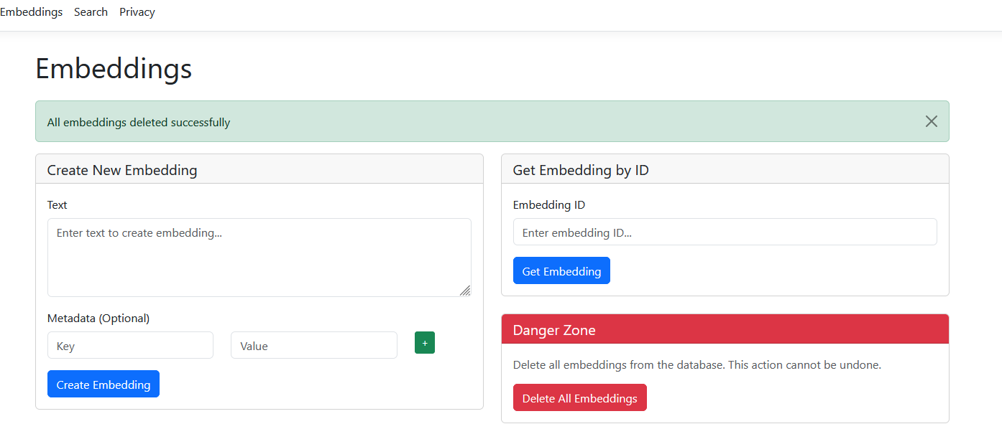
VECTOR Similarity Search Process
Query → Vectorisation → Index → Search → Results.
Use icons for each step (document, matrix, database, magnifying glass, list).
Demo time!

Slide 11
INDEXING methods
3-column layout:
Brute Force → slow icon (turtle)
ANN → fast icon (rabbit)
HNSW/IVF/PQ → small network diagrams
Include speed vs accuracy bar chart.

Slide 12
Real-World Applications
Grid of 4 images:
E-commerce product grid.
Image search results.
Medical scan comparison.
Face recognition overlay.

Slide 13
CHALLENGES
Warning icons with short text:
Storage icon → “High-dimensional cost”
Scales icon → “Bias in embeddings”
Refresh icon → “Dynamic datasets”

Slide 14
Future Trends
Futuristic gradient background.
cons for:
Multimodal AI (text+image+audio combined)
Mobile device with lock (on-device search)
AI brain with gears (self-learning indexes).

Slide 15
Summary
Data -> Vectors
Vectors -> Similarity Search
AI -> Smarter Results
Slides and code: https://github.com/johnstaveley/Vectorisation
Any questions?

